Slide 1
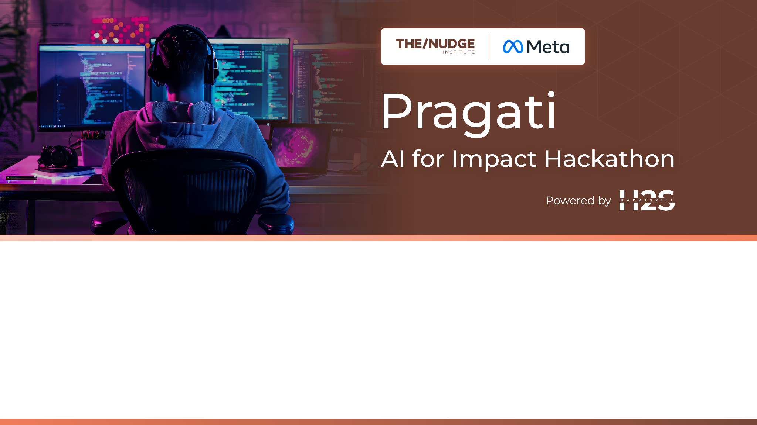
Team Name : Morning Group
Team Leader Name : Vignesh Naik
Which domain does your idea address? (Agriculture / Healthcare / Skilling / Education): Healthcare

Slide 2



Problem
Rural India suffers from high infant mortality because of undernutrition and late detection of pregnancy complications. ASHA/ANM workers do not have digital tools to provide context-specific, language-friendly advice offline. This is exacerbated by weak connectivity and language issues, preventing timely interventions and efficient data management.

Slide 3
Our Solution
How we differentiate? And what impact we aim to create?
We propose an offline tablet powered by an optimized Meta LLaMA model. It offers real-time, voice-based support in Indian languages using ASR (Whisper/Indic-ASR) and TTS (Vakyansh). The assistant provides localized dietary advice, flags high-risk pregnancies from symptom inputs, and securely stores patient data. With internet access, it syncs anonymized data and updates via Firebase or REST APIs.
Impact:
Reduced infant and maternal mortality, reduced Anemia Cases in Infants, empowered ASHA/ANM workers in making informed decisions, enhanced follow-up of vaccination and nutrition programs, and reduced healthcare data management complexity.
What makes our solution different?
Offline-first and voice-enabled, our system works reliably in low-resource settings, offering culturally aware advice without internet. Federated sync ensures continuous improvement without compromising user privacy.
USP: Offline AI assistance, in-region language interactions, personalized health advice, and secure automated data gathering.

Slide 4
Our Primary Users
How Open Source is enabling us to solve the problem efficiently
The key users of our solution are ANM and ASHA workers in rural India, who are central to infant and maternal care. Our solution uses open-source AI, in particular Meta LLaMA 3 fine-tuned for multi-domain maternal and infant nutritional counselling. Upon the registration of a pregnancy by the mother, high-risk cases are identified by the system and relevant dietary suggestions made for prenatal support. After childbirth, it advises personalized inputs both for mother and baby, focusing on locally accessible and culturally relevant food items.
On-device inference allows for real-time voice-based interactions without internet connectivity.
Speech recognition is managed by Whisper/Indic-ASR, and natural language generation is driven by Vakyansh TTS, both supporting local Indian languages.
Offline-first design provides seamless functionality in low-resource and low-connectivity regions.
Sensitive patient information is stored safely using encrypted local SQLite databases.
Federated sync updates health guidelines, dietary advice, and model weights whenever connectivity is established.
Ongoing learning from actual inputs sharpens dietary and health guidance over time.
The system equips ASHA/ANM workers with actionable intelligence, enhancing field-level decision-making.
Delivers culturally appropriate and uniform care during pregnancy and early motherhood.

Slide 5
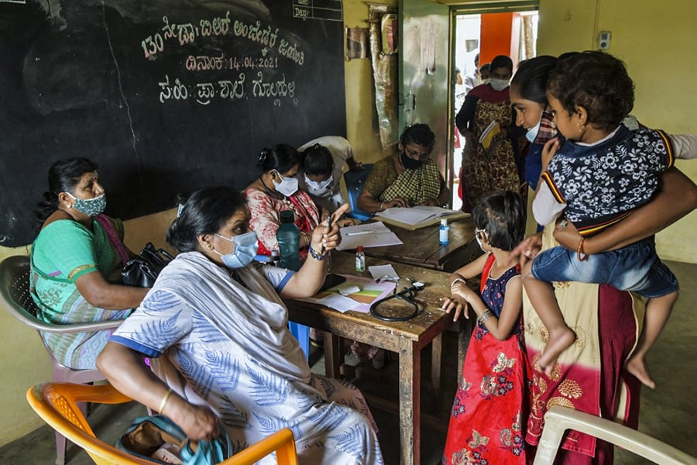
And yes our solution is scalable too… here's how
The solution is scalable by design—it supports adding new regional languages and expanding to other health domains (e.g., child immunization, TB detection) with minimal retraining of the LLaMA model.
Its open-source stack reduces costs and facilitates bulk deployment across rural areas.
The offline-first architecture, combined with periodic secure cloud sync, ensures that as more data is collected, the system’s accuracy and capabilities continue to improve.
Centralized dashboards allow for monitoring and updates across many devices, enabling easy horizontal scaling.

Slide 6
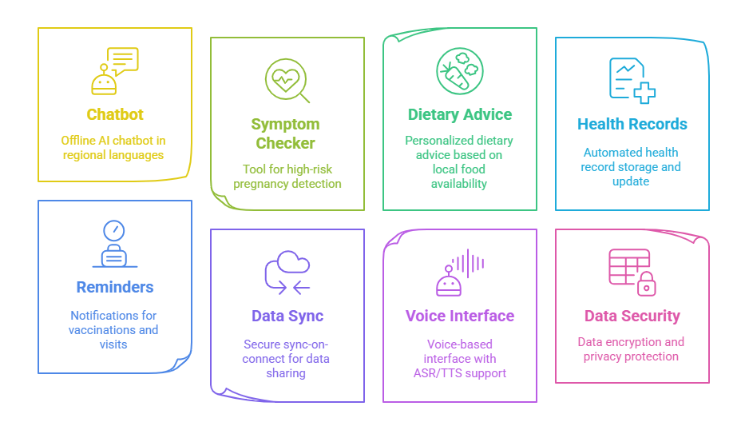
Features of our Solution.

Slide 7
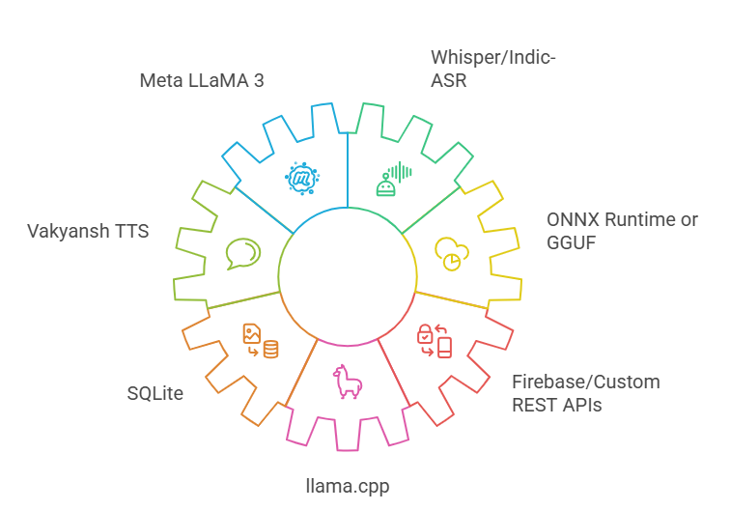
What Open Source Tools are we intending to use?
Meta LLaMA 3
Whisper / Indic-ASR
Vakyansh TTS
ONNX Runtime or GGUF (for quantized model serving)
SQLite for local data storage
Firebase or custom REST APIs for secure sync
llama.cpp for on-device inference

Slide 8
Why these open source tools the most appropriate?
Meta's LLaMA 3 is a lightweight yet potent NLP model best suited for on-device inference, which is critical in low-resource environments.
Whisper and Indic-ASR enable strong speech recognition in Indian languages with the accuracy needed for voice input.
Vakyansh TTS generates natural-sounding, intelligible speech output in regional dialects, which is critical for non-literate users.
ONNX Runtime or GGUF performs inference optimization, minimizing computational workload and power consumption, making the solution feasible on low-cost tablets.
SQLite provides secure local storage, and Firebase or custom REST APIs provide secure, encrypted data synchronization when connected.
This open-source stack is customizable, affordable, and built to honor user privacy—addressing the distinct challenges of rural healthcare.

Slide 9
Solutions Architecture
Our solution design is for an offline-first, fault-tolerant system that delivers smart health assistance in rural regions. It consists of five major layers:
Voice Interface Layer: This layer takes care of all voice interactions. ASHA/ANM workers utter their questions in their mother tongue. A built-in ASR engine—based on Whisper or Indic-ASR—converts the speech into text. In parallel, a TTS system (Vakyansh) renders text replies back into good audio. This two-way ability provides a natural conversational flow.
AI Inference Layer: At its center is the optimized Meta LLaMA 3 model, tuned for on-device efficiency. Through frameworks such as ONNX Runtime or GGUF (via llama.cpp), the model reads the transcribed text to determine the query and provide accurate answers. The inference engine is crafted to run well on budget tablet hardware.
Personalization & Alert Engine : This module incorporates patient-specific information like patient history, regional eating habits, and local campaign health details. It personalizes diet suggestions and highlights high-risk signs. Reminders are sent for important events like due dates for immunization or antenatal checkup for timely intervention.
All patient data, interaction records, and config settings are stored in an encrypted SQLite database within the device in a secure way. All this local data store is such that health records are kept available even offline and ensure data integrity and privacy.

Slide 10
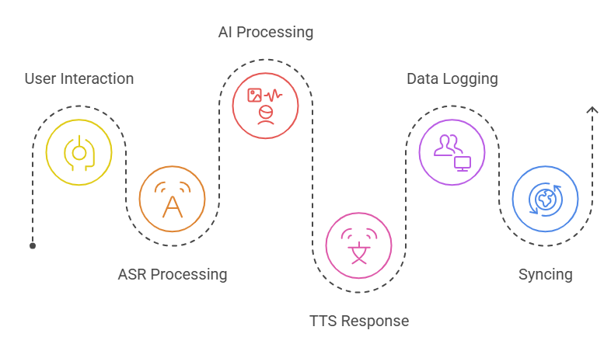
Solutions Architecture
Secure Sync & Federated Learning Layer: When the device is in a network area (e.g., close to a PHC), it triggers the secure sync module. This module, via Firebase or custom REST APIs, encrypts and uploads anonymized health records to a central cloud server. It also downloads updates such as improved model weights, updated nutrition information, and government health alerts. This layer enables federated learning, such that the on-device model improves over time while keeping individual data secure.
Deployment Options: It comes preloaded onto rugged, cost-effective Android or Linux tablets. It has the capability to run offline with the possibility of solar charging in the off-grid location. The modular design provides simple maintenance, scalability,and the ability to adjust to various rural environments.

Slide 11
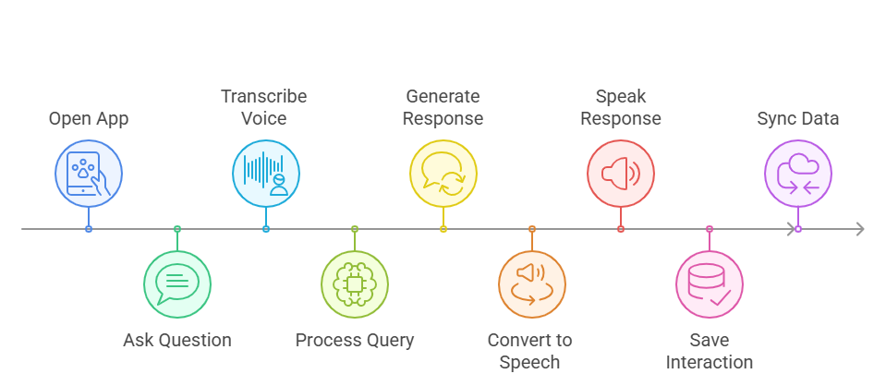
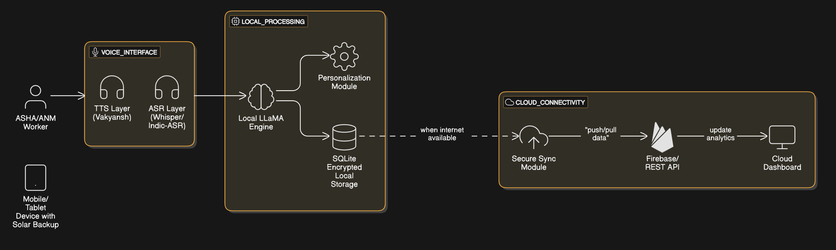
Provide a high-level architecture diagram or a use-case diagram of your proposed solution
User-Flow Diagram
Architecture Diagram

Slide 12
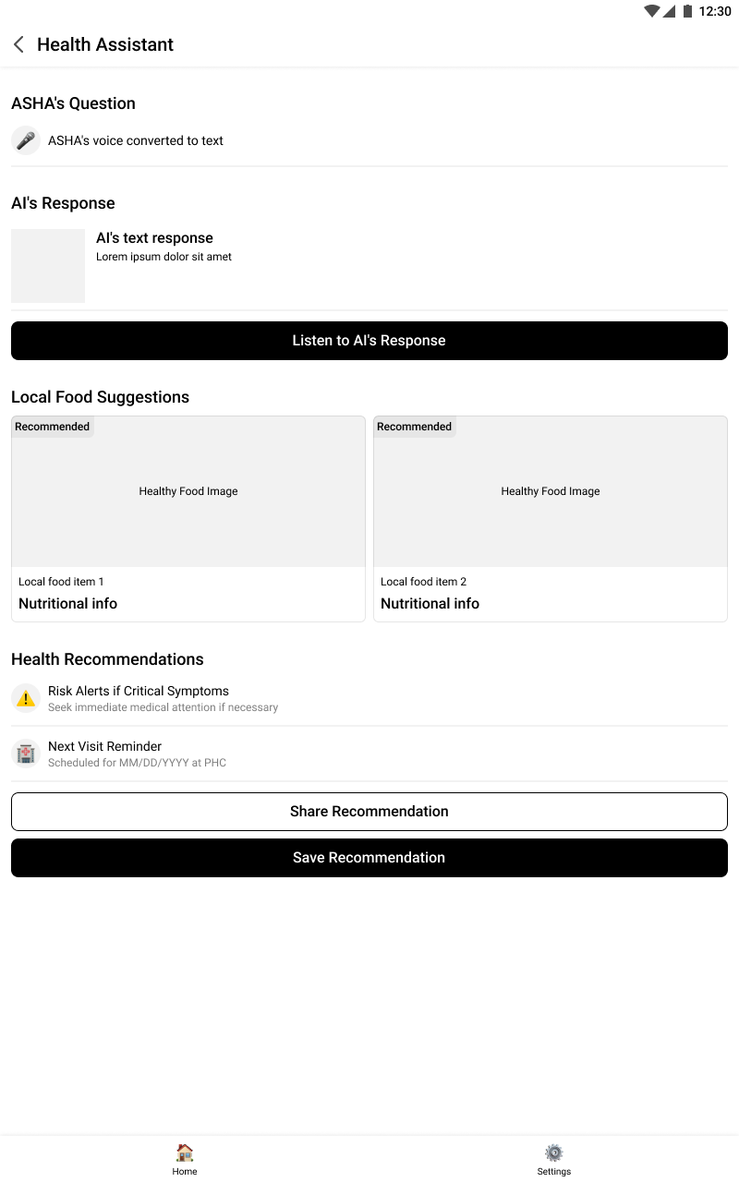
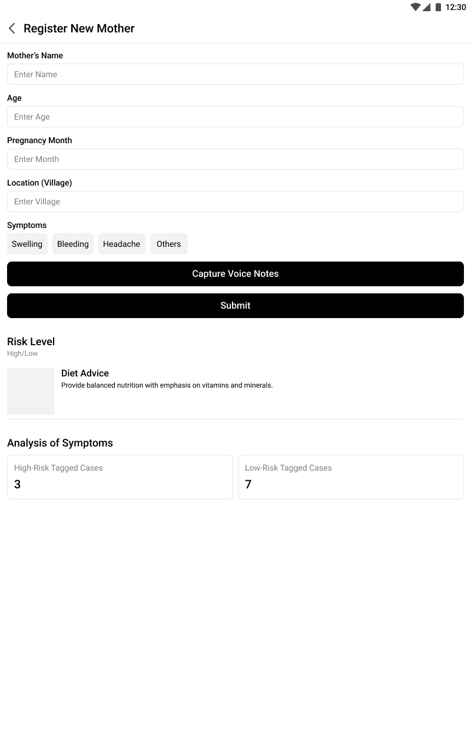
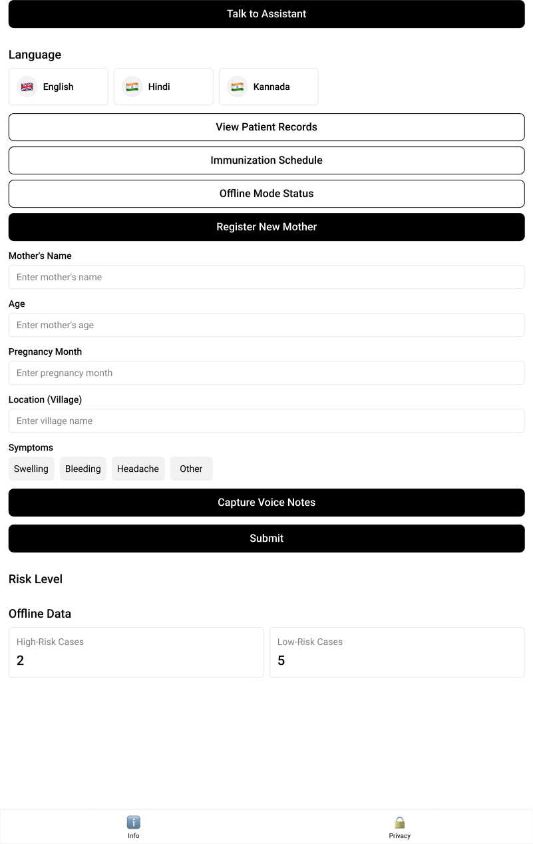
Wireframes

Slide 13

What Datasets are we using?
Datasets comprise publicly accessible resources such as HMIS datasets from the Government of India, AI4Bharat corpora for nutrition and language data, and maternal health knowledge bases.
Also included will be user-generated data (patient case records entered by ASHA workers) and synthetic data for training on regional language variations.

Slide 14

And it’s all offline, on-device
The solution is largely on-device, with the Meta LLaMA model being fine-tuned to do all the important computation locally for real-time responsiveness.
Cloud services are utilized only for periodic sync—uploading anonymized health records and downloading updates like improved model weights and new health data.
This offline-first approach reduces reliance on constant connectivity, lowers operational expenses, and makes the system work even in regions with low network coverage.

Slide 15
